Slide 1
Let Jesus Lead
Notes:
The hallmark of every great leader is the ability to lead oneself. This means facing your limitations and leaning on your Maker. We lead best by allowing God to lead us.
Some object: “You can’t be humble in my line of work. You can never show weakness or people will run right over you!”
Humility doesn’t equate to weakness. Rather, it’s where we find our strength. Or better yet, humility is the place we access God’s supply.

Slide 2
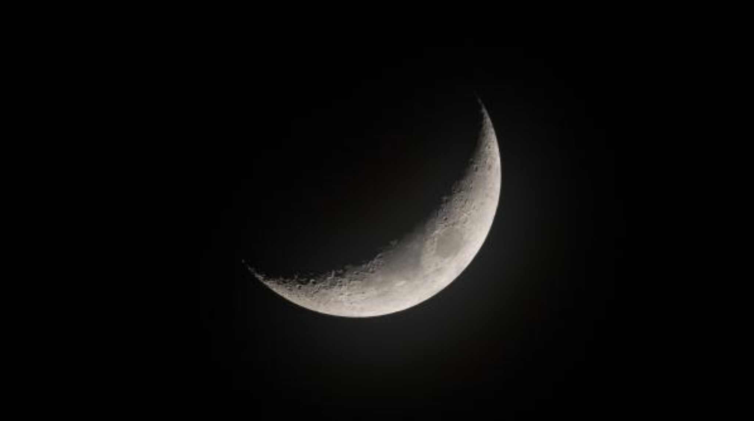
You don’t have to be full to be a light in the darkness. You just have to be able to see the Sun when no one else can.

Slide 3
John 21:15-19(ESV)
[15] When they had finished breakfast, Jesus said to Simon Peter, “Simon, son of John, do you love me more than these?” He said to him, “Yes, Lord; you know that I love you.” He said to him, “Feed my lambs.” [16] He said to him a second time, “Simon, son of John, do you love me?” He said to him, “Yes, Lord; you know that I love you.” He said to him, “Tend my sheep.” [17] He said to him the third time, “Simon, son of John, do you love me?” Peter was grieved because he said to him the third time, “Do you love me?” and he said to him, “Lord, you know everything; you know that I love you.” Jesus said to him, “Feed my sheep. [18] Truly, truly, I say to you, when you were young, you used to dress yourself and walk wherever you wanted, but when you are old, you will stretch out your hands, and another will dress you and carry you where you do not want to go.” [19] (This he said to show by what kind of death he was to glorify God.) And after saying this he said to him, “Follow me.”

Slide 4
L E A D S E L F
Disciplemaking
L E A D O T H E R S
L E A D O R G A N I Z A T I O N S
Leadership
L E A D T E A M S

Slide 6
Psalm 78:70-72
He chose David his servant
and took him from the sheepfolds;
from following the nursing ewes he brought him
to shepherd Jacob his people,
Israel his inheritance.
With upright heart he shepherded them
and guided them with his skillful hand. (ESV)

Slide 7
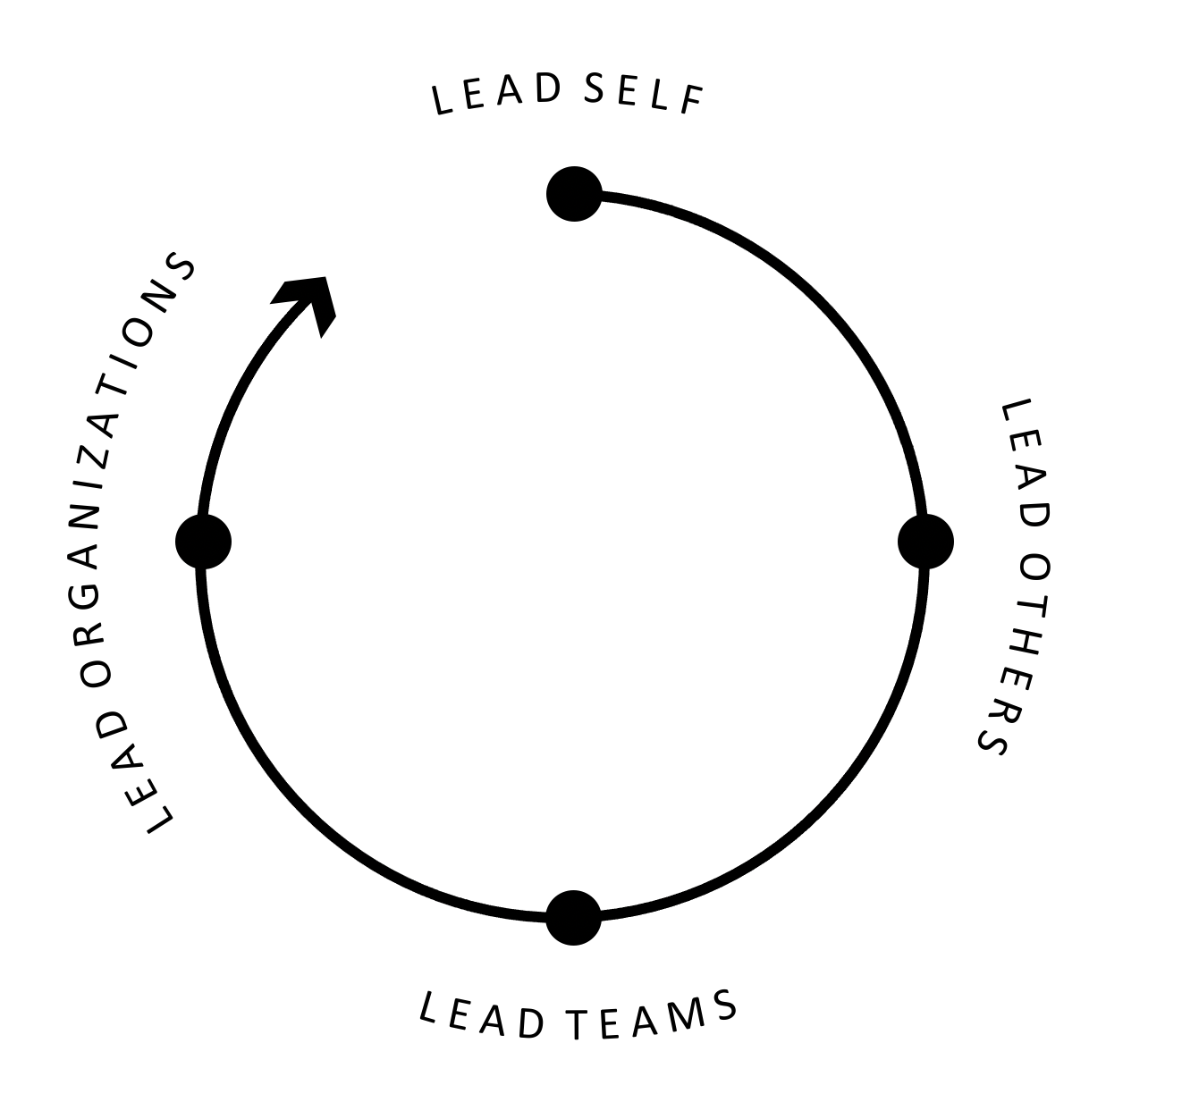
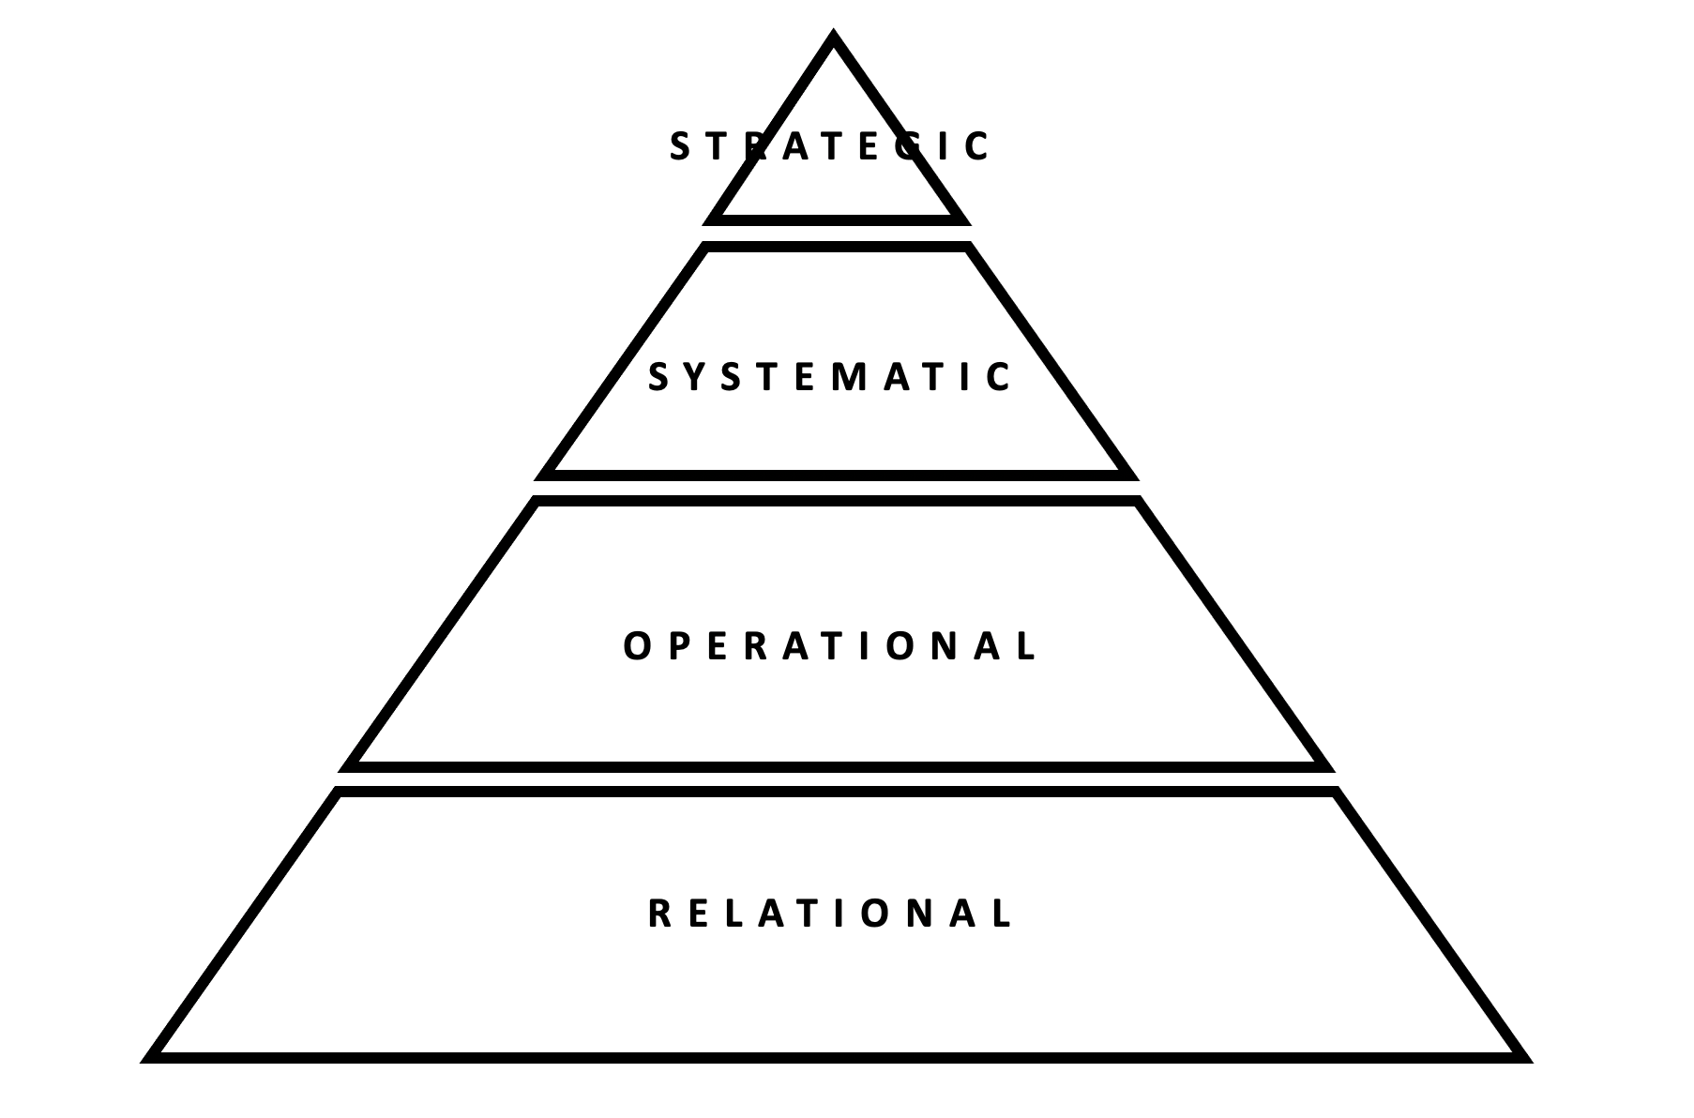
Gospel Realities
Arenas of Leadership
Levels of Leadership
Gospel Clarity
Gospel Destiny
Gospel Identity

Slide 8
One way of looking at how
God blows up the world
Gospel Clarity
Gospel Destiny
Gospel Identity

Slide 9
Gospel Destiny
Our chief purpose is to glorify God
and enjoy him forever.
A Christian leader is first
a lead worshiper.

Slide 10
Gospel Clarity
4 Gospel Declarations:
The Kingdom of God is here.
Jesus is the King of that Kingdom.
Jesus died in our place on the cross.
Jesus rose from the dead on the third day.
3 Gospel Responses:
Repent – Of our unbelief about Jesus
Believe – The four declarations
Follow – Arrange your life to say “yes” to Jesus

Slide 11
Gospel Identity
Healthy worshipper:
Worship God joyfully and passionately
Healthy family:
Connect with one another authentically
Healthy missionary:
Go, show and tell the gospel boldly

Slide 12
One way of looking at how
God develops us
L E A D S E L F
L E A D O T H E R S
L E A D O R G A N I Z A T I O N S
L E A D T E A M S

Slide 13
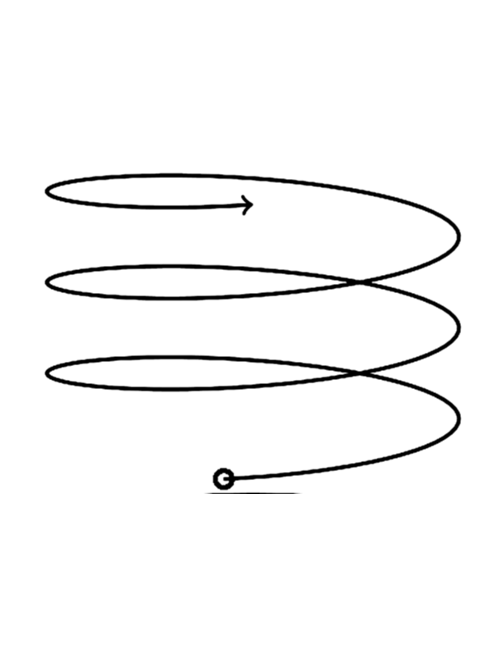
G R O W T H

Slide 14
L E A D S E L F
Disciplemaking
L E A D O T H E R S
L E A D O R G A N I Z A T I O N S
Leadership
L E A D T E A M S

Slide 15
One way of looking at how
God grows organizations
STRATEGIC
SYSTEMATIC
OPERATIONAL
RELATIONAL
Notes:
The Why – God’s Glory. It is buried in the first target on purpose.

Slide 16
STRATEGIC
At this level, people follow primarily because of how they are treated.
SYSTEMATIC
OPERATIONAL
RELATIONAL
Notes:
The Why – God’s Glory. It is buried in the first target on purpose.

Slide 17
STRATEGIC
At this level, people follow primarily because of positional and intellectual authority.
SYSTEMATIC
OPERATIONAL
RELATIONAL
Notes:
The Why – God’s Glory. It is buried in the first target on purpose.

Slide 18
STRATEGIC
At this level, leadership transitions from personal dynamics, into a focus on building effective systems that instill trust.
SYSTEMATIC
OPERATIONAL
RELATIONAL
Notes:
The Why – God’s Glory. It is buried in the first target on purpose.

Slide 19
STRATEGIC
At the Relational, Operational, and Systematic levels, the focus is on helping the organization get better at what it does.
SYSTEMATIC
OPERATIONAL
RELATIONAL
Notes:
The Why – God’s Glory. It is buried in the first target on purpose.

Slide 20
STRATEGIC
At the Strategic Leadership level, the focus is more external and emphasizes how to transform the organization into who it wants to become.
SYSTEMATIC
OPERATIONAL
RELATIONAL
Notes:
The Why – God’s Glory. It is buried in the first target on purpose.

Slide 21
One way of looking at how
we hit the wall
STRATEGIC
SYSTEMATIC
OPERATIONAL
RELATIONAL
Notes:
The Why – God’s Glory. It is buried in the first target on purpose.

Slide 22
Scarcity Mindset vs Abundance Mindset
Scarcity Mindset: Really intelligent people are a rare breed. I am of that breed. People will never figure things out without me. There are no leaders in my church/organization. Maybe doubt God’s ability to transform lives.
Asks: Is this person smart?
Abundance Mindset: Smart people are everywhere. Believe that intelligence and ability can be cultivated through effort. They assume people are smart and will figure it out. Believe in spirit-driven spiritual formation.
Asks: In what way is this person smart?

Slide 23
Getting Stuff Done vs Developing People
Getting Stuff Done: Focused on the task or the initiative. People are needed to help get it done. Recruiting is done based on need.
Asks: What abilities and skills do you have? Where and how can you serve?
Developing People: Every task and every initiative is an excuse to make disciples and develop people.
Asks: What is the next step the Lord is asking you to take in your walk with Him? How can you bring the most glory to Him in this season.

Slide 24
Transactional Leadership
Power
Wielding
Transformational Leadership
Use/Abuse
Exchange
Love
You are expendable.
You are valuable because of what you can do.
You are valuable because of who you are.

Slide 25
Team-building Competencies
Give control, not take control
Build trust = Transparency + Time
Make it safe, not stressful

Slide 26
Move you from
What would Jesus do?
Lead like Jesus.
Jesus be with us.
A form of godliness without power.
What is Jesus doing?
Let Jesus lead.
Open our eyes to see you.
A demonstration of God’s power.

Slide 27
Judges 2:7
The people served the LORD all the days of Joshua and all the days of the elders who survived Joshua, who had seen the work of the LORD which He had done for Israel. (NASB)

Slide 28
John 13:37-38
Peter said to him, “Lord, why can I not follow you now? I will lay down my life for you.” Jesus answered, “Will you lay down your life for me? Truly, truly, I say to you, the rooster will not crow till you have denied me three times. (ESV)

Slide 29
John 21:18-19
Truly, truly, I say to you, when you were young, you used to dress yourself and walk wherever you wanted, but when you are old, you will stretch out your hands, and another will dress you and carry you where you do not want to go.” (This he said to show by what kind of death he was to glorify God.) And after saying this he said to him, “Follow me.” (ESV)

Slide 30
1 Peter 5:1-4
So I exhort the elders among you, as a fellow elder and a witness of the sufferings of Christ, as well as a partaker in the glory that is going to be revealed: shepherd the flock of God that is among you, exercising oversight, not under compulsion, but willingly, as God would have you; not for shameful gain, but eagerly; not domineering over those in your charge, but being examples to the flock. And when the chief Shepherd appears, you will receive the unfading crown of glory. (ESV)

